Slide 1
推荐信布局和策划
GGU Consulting 2017

Slide 2
A. 谁可以作为你的推荐人（三种人）
科研老板—Advisor
任课老师– Professor
实习上司– Supervisor
如下的人不能作为推荐人：师兄、师姐、师弟、师妹、朋友、邻居、看着长大的叔叔（阿姨、伯伯、婶婶等）、远方的亲戚、父母说有关系的但没见过的教授；
但并不排除把有价值的、不适合的潜在推荐人，变成推荐人（世毕盟有策略）；

Slide 3
B. 推荐信操作流程
1. 填信息
2. 各项指标打分
3. 上传PDF文件
4. 检查和提交
注意：流程和IP地址问题；

Slide 4
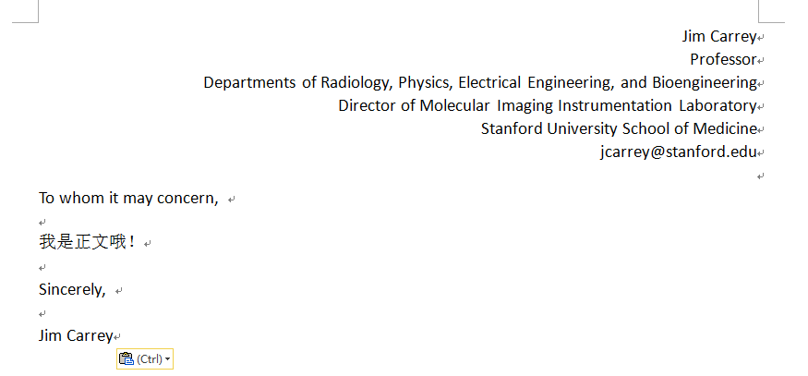
C. 长度和格式
1. 长度: 250-350字为宜
2. 格式

Slide 5
D. 推荐信正文
称呼
首段
中间段
结尾段
其他的见格式部分；

Slide 6
D. 推荐信正文
称呼
To Whom It May Concern,
Dear Graduate School Selection Committee,

Slide 7
D. 推荐信正文
2. 首段
1）自我介绍；
2）和申请者的关系，认识的时间和原因；
As Weiguang’s research adviser, I have known him for more than one year. (You can also tell a long story.)
3）概况中间段；
4）其他；

Slide 8
D. 推荐信正文
2. 首段
1）自我介绍；
Let the committee know that “you” are an expert in the area. E.g.: I am an associate professor at Tsinghua University, and I got my PhD degree in Nagoya University in Japan. My research group is one of the most famous ones that do research in dye-sensitezed solar cell (DSSC) all over the world, with XX papers published in SCI source journals.

Slide 9
D. 推荐信正文
2. 首段
2）和申请者的关系，认识的时间和原因；3）概况中间段；4）其他；
例子：My name is Jim Carrey. I am a Professor and Director of Molecular Imaging Instrumentation Laboratory at Stanford. In summer 2013, Mr. XXX XXXXX came to our department through a program, Undergraduate Visiting Researcher (UGVR/REU) Program, and worked under my supervision. I would say that XXX ranks Top 1% in all undergraduate students that I supervised in these 10 years. Thus, I strongly recommend him to your program for further study.

Slide 10
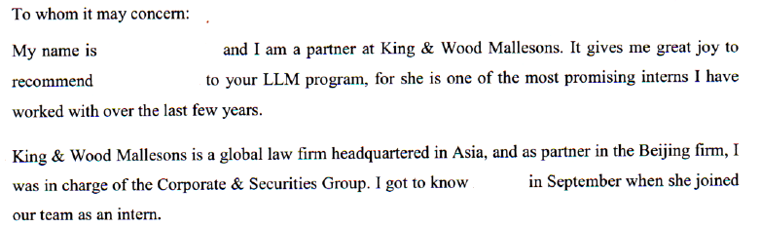
D. 推荐信正文
2. 首段
又如：

Slide 11
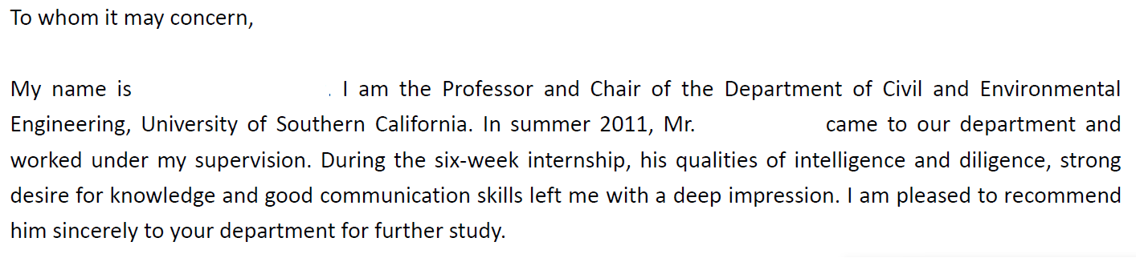
D. 推荐信正文
2. 首段
又如：

Slide 12
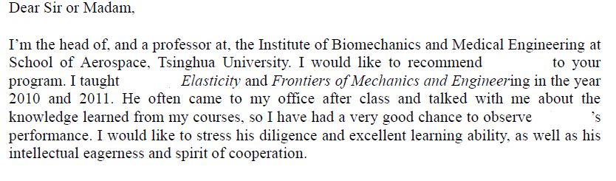
D. 推荐信正文
2. 首段
又如：

Slide 13
D. 推荐信正文
3. 中间段 （论点+论据）例子1 List the applicant‘s exceptional qualities and skills, especially those that are related to the applicant’s field of interest or job search. Give specific examples to back up what you have written.
Bimeng is one of the most ambitious young men I know on his targeting field. It is not easy for an undergraduate student to take further research in other institutions, but he did it, and did a very good job here. In just a few weeks, he started a new direction – single chamber SOFC in my group, with summarizing related literature, selecting cell component materials, and designing of cell structure.

Slide 14
D. 推荐信正文
3. 中间段 (论点+论据) 例子2 Mr. Bimeng SHI first took part in my SRT project – study of relationship between microstructure and mechanical behavior of porous ceramics using Finite Element Method. I originally intended to enroll a student who had a strong background of physics and was familiar with FEM modeling because I knew it was really a tough task especially for an undergraduate student. Mr. Bimeng didn’t have any former experience of FEM Modeling but quickly showed his high intelligence in this area. I was deeply impressed by his ability to acquire new knowledge and put it into use appropriately.

Slide 15
D. 推荐信正文
3. 中间段 (论点+论据) 例子3 Bimeng SHI mainly focused on the image enhancement of a high resolution PET camera through detector misalignment correction. He was the first one who finished a comprehensive and in-depth study on this problem. He conducted great amount of work independent including 1mm-resolution PET camera simulation, signal processing and fast image reconstruction using GPU. One of his great work impressed me is that he proposed an inspiring idea of estimating the inter-panel misalignment and correcting the image distortion correspondingly. He independently realized the algorithm and validated it in experiments. His innovative algorithm can help to compensate the image distortion in the existing system and significantly improve the image quality with much higher resolution and SNR. His work greatly contributed our study and the manuscript about this work is in preparation.

Slide 16
D. 推荐信正文
3. 中间段 (论点+论据) 例子4 Bimeng SHI is very diligent and has great learning potential. He always previewed future class lessons and took very detailed notes in every class. He would go over the notes after class and think in his own way, then write down the questions he encountered and discuss them with me. He always sat at the first or second row in class in order to get a chance to interact with me. In the final exam of both my courses, he got very high scores. Especially in Elasticity, he got a score of 93 out of 100. I believe that his diligence and excellent learning ability has created a solid foundation for him to begin to further his studies.

Slide 17
D. 推荐信正文
3. 中间段 (论点+论据) 例子5 Bimeng SHI accomplished her work with precision and efficiency. In her primary project, a non-public offering, Bimeng demonstrated her potential to become a great investment banker. For this intensive project, she was responsible for updating and revising the financial due-diligence report. She frequently finished her work in advance with high precision, and left enough time to double check her work and guarantee that there were no errors. She also actively communicated with her other team members, ensuring that everyone was informed on the progress of the project. While working on the drafts for this project, she demonstrated a logical and efficient analytical approach. While analyzing the entire company itself, she thoroughly examined all the relevant documents and effectively communicated with the client. During the final phase of the project, she still met all her deadlines despite having a very demanding workload. I was very impressed by her perseverance and ability to manage her work and the stress that comes from our intensive working environment.

Slide 18
D. 推荐信正文
4. 结尾段 例子1
Last but not least, I’d like to mention that all students from my group are outstanding among peers. Several seniors of XX are pursuing a PhD in US. For example, HW is now a PhD candidate in California Institute of Technology, PG in Northwestern University, and SX in Carnegie Mellon University. XX is following their examples and is doing quite well. Now he is researching on XXXX under the guidance of my PhD student FL.
Above all, I think he can do a great job in your PhD program. My email address is xxxx, and don’t hesitate to contact me for more information.

Slide 19
D. 推荐信正文
4. 结尾段 例子2
In summary, I believe that Bimeng Shi’s enthusiasm for this industry will greatly benefit her. Based on her performance during this internship, she fulfills my definition of an investment banker and therefore I believe she is an ideal candidate for your program. If I can be of any further assistance, or provide you with any further information for your consideration, please do not hesitate to contact me.

Slide 20
D. 推荐信正文
4. 结尾段 例子3
In summary, Bimeng Shi’s diligent and excellent learning ability, eagerness in learning and spirit of cooperation impressed me. Combined with my working experience, it’s no doubt that Bimeng Shi will do a good job in your program. I ask that you look upon his application favorably and grant him a chance to study in your program. Your favorable consideration will be highly appreciated.

Slide 21
D. 推荐信正文
4. 结尾段 例子4
Mr. Bimeng Shi left me with a deep impression. We appreciate his participation and contribution. He did a truly outstanding job on his project. From his time with us, I have 100% confidence that Mr. Shi will be a successful researcher in the future. Your favorable consideration of his application would be most appreciated. If you have any questions, please do not hesitate to contact me.

Slide 22
E. 有关推荐信的注意事项
提交的IP，以及PDF文件的属性；
不要个性化抬头；
4种推荐人及应对策略；
1）完全放权，甚至提供邮箱密码；2）检查推荐信内容，其他放权；3）要草稿，但是自己独立提交；4）完全独立完成全部内容；
4. 教师节的问候；
5. Weekly Self-report

Slide 23
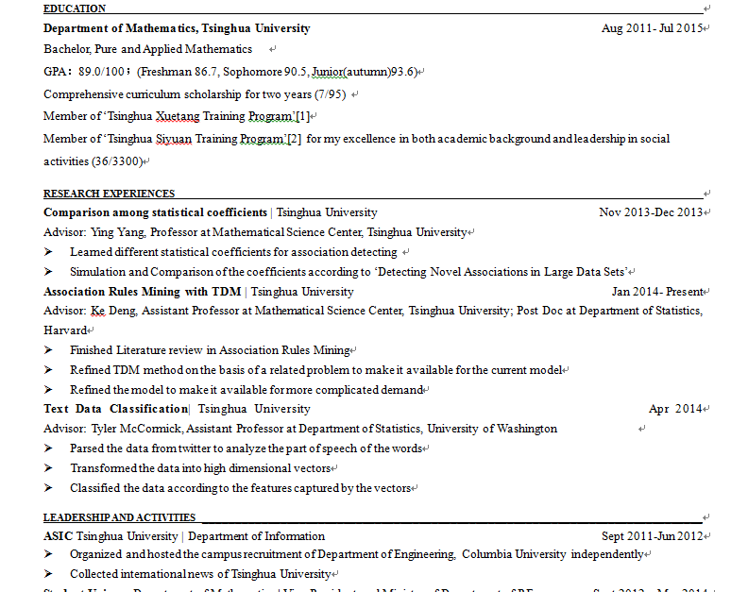
Show Time

Slide 24
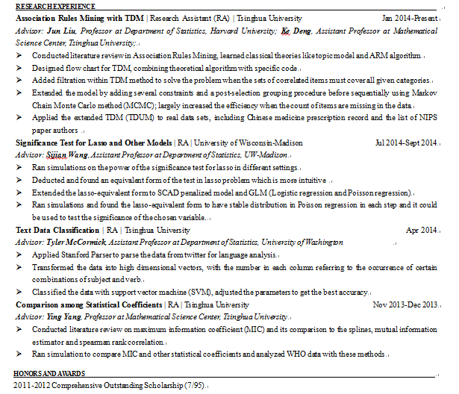
Show Time

Slide 25
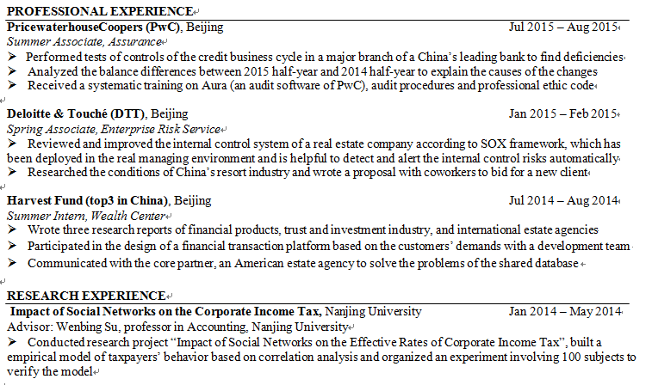
Show Time

Slide 26
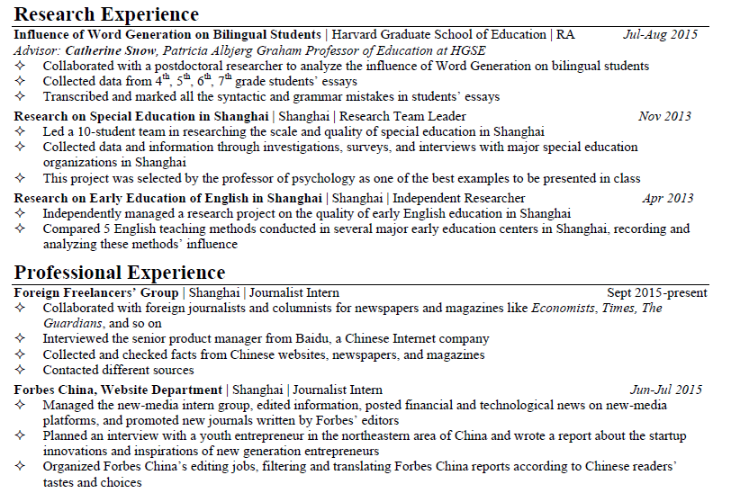
Show Time

Slide 27
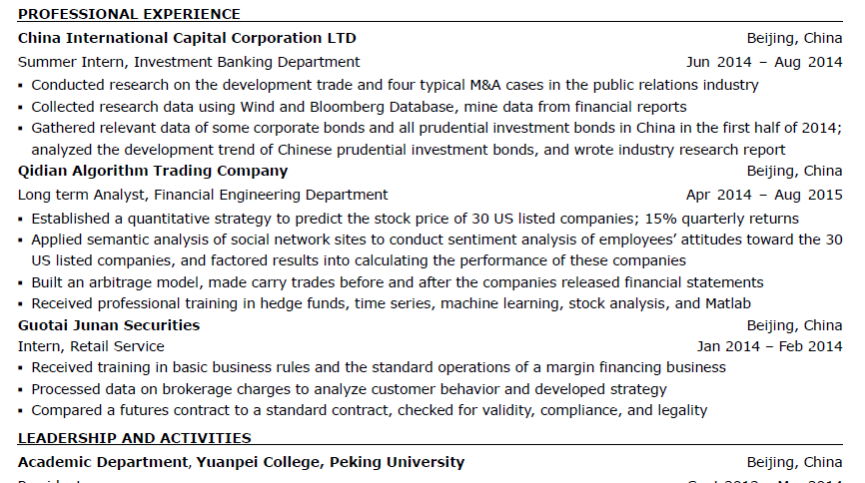
Show Time

Slide 28
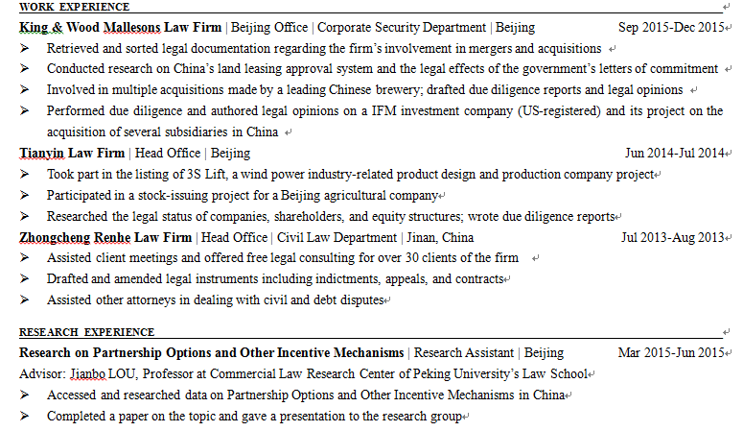
Show Time

Slide 29

Q&A

